Slide 1
Investment Research & Analysis
FMCG Sector in India: Investment Opportunities 2024-2033
Investment Banking & Financial Analytics Project
Market Size: USD 245.39B → USD 1.1T (4.5x Growth Potential)
December 2025 | CAGR: 17.33%

Slide 2
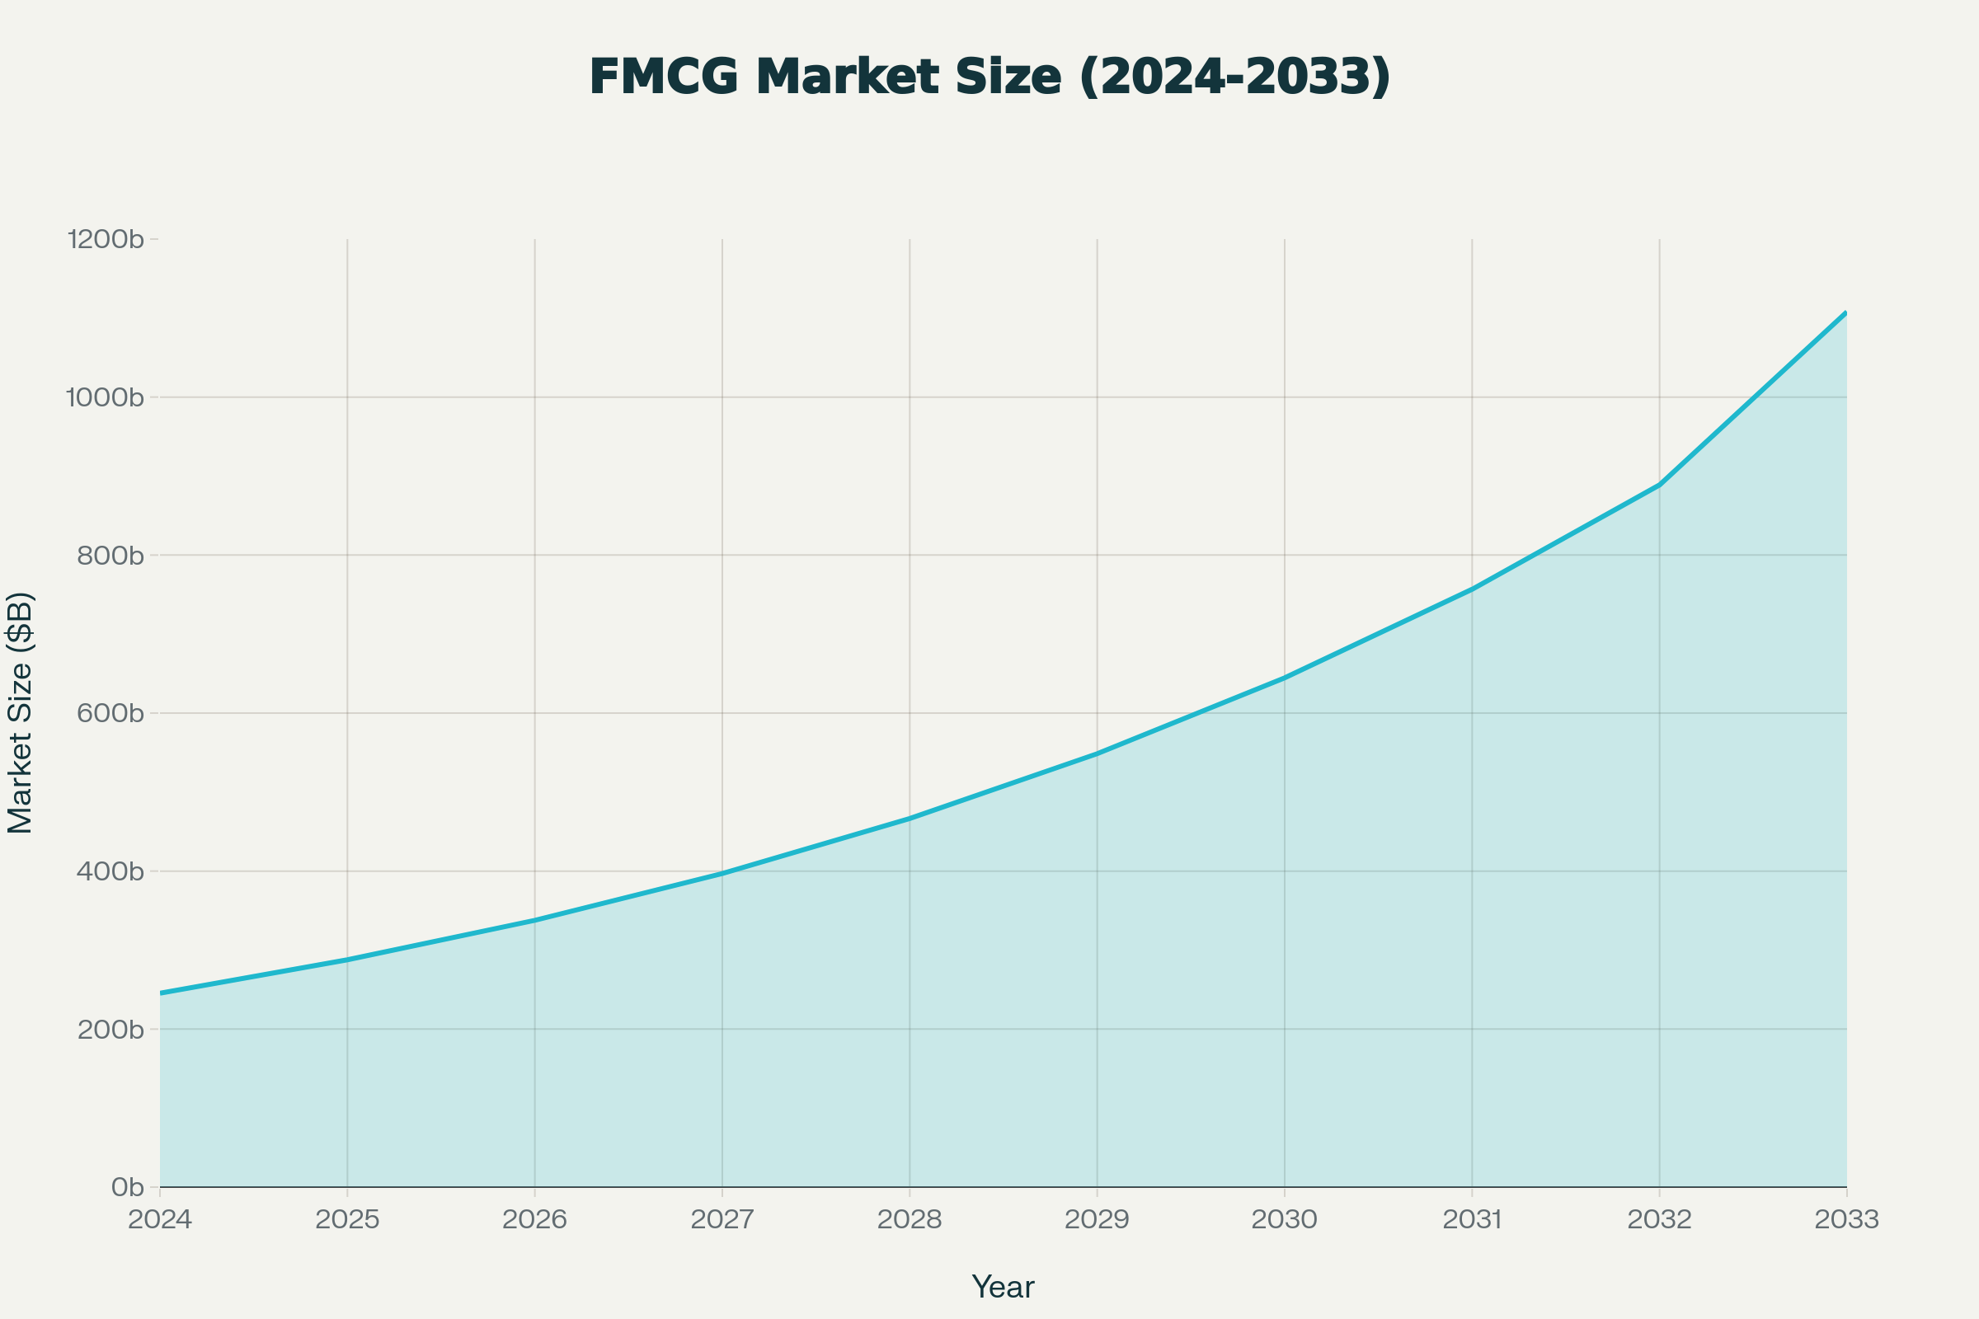
Sector Overview: FMCG in India
Market Size (2024)
USD 245.39 Billion
Projected Size (2033)
USD 1,108 Billion
Growth Multiple
4.5x (9 Years)
CAGR: 17.33% (Above GDP growth)
Key Segments: Food (30%), Personal Care (40%), Household (30%)
Drivers: Urbanization, rising incomes, e-commerce, health trends
Investment Appeal: Defensive, resilient, high growth

Slide 3
Market Trends & Consumer Evolution
Health & Wellness
Natural/organic products growing at 1.8x conventional alternatives. 60% consumers seek functional benefits.
Digital Disruption
65% multi-channel consumers. Quick commerce captured 15% of urban sales, growing 45% YoY.
Rural Focus
56% of companies targeting Tier 2/3 towns. Volume growth 8%+ in rural markets.
Premiumization
45% of leaders see premium products as growth driver. D2C channels growing 45% YoY.

Slide 4
Competitive Landscape: Top 5 Players
🥇 ITC Limited
Market Share: 14% (Largest)
Market Cap: ₹5.02L Cr
Brands: Aashirvaad, Sunfeast, Engage
P/E: 24.89x ✓ (Undervalued)
🥈 HUL
Market Share: 12%
Market Cap: ₹5.82L Cr
Brands: Lux, Lipton, Vaseline
P/E: 53.03x (Premium)
🥉 Nestle
Market Share: 3% (Premium)
Cerelac: 96% dominance
Key: Maggi, Nescafé
P/E: 81.24x (Expensive)
Britannia
#1 Biscuits, 3% share, ₹1.42L Cr market cap | P/E: 61.22x
Godrej Consumer
Niche player, 2% share, ₹1.16L Cr market cap | P/E: 61.67x

Slide 5
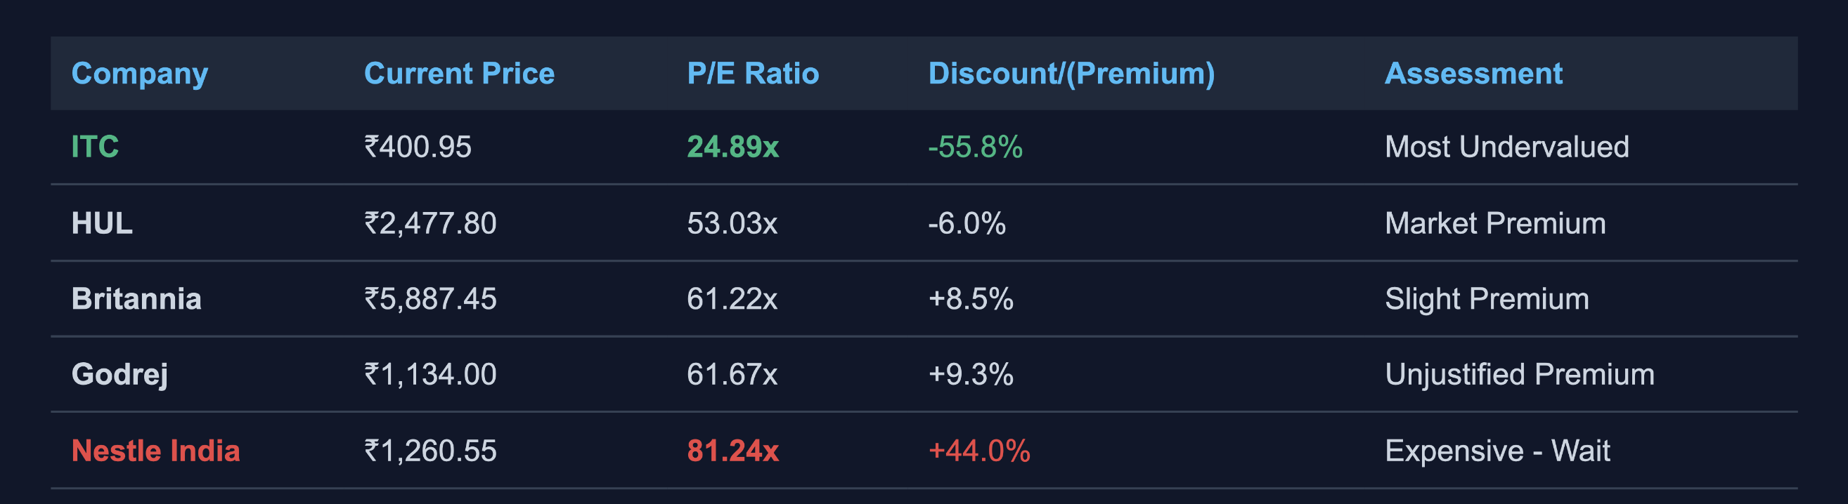
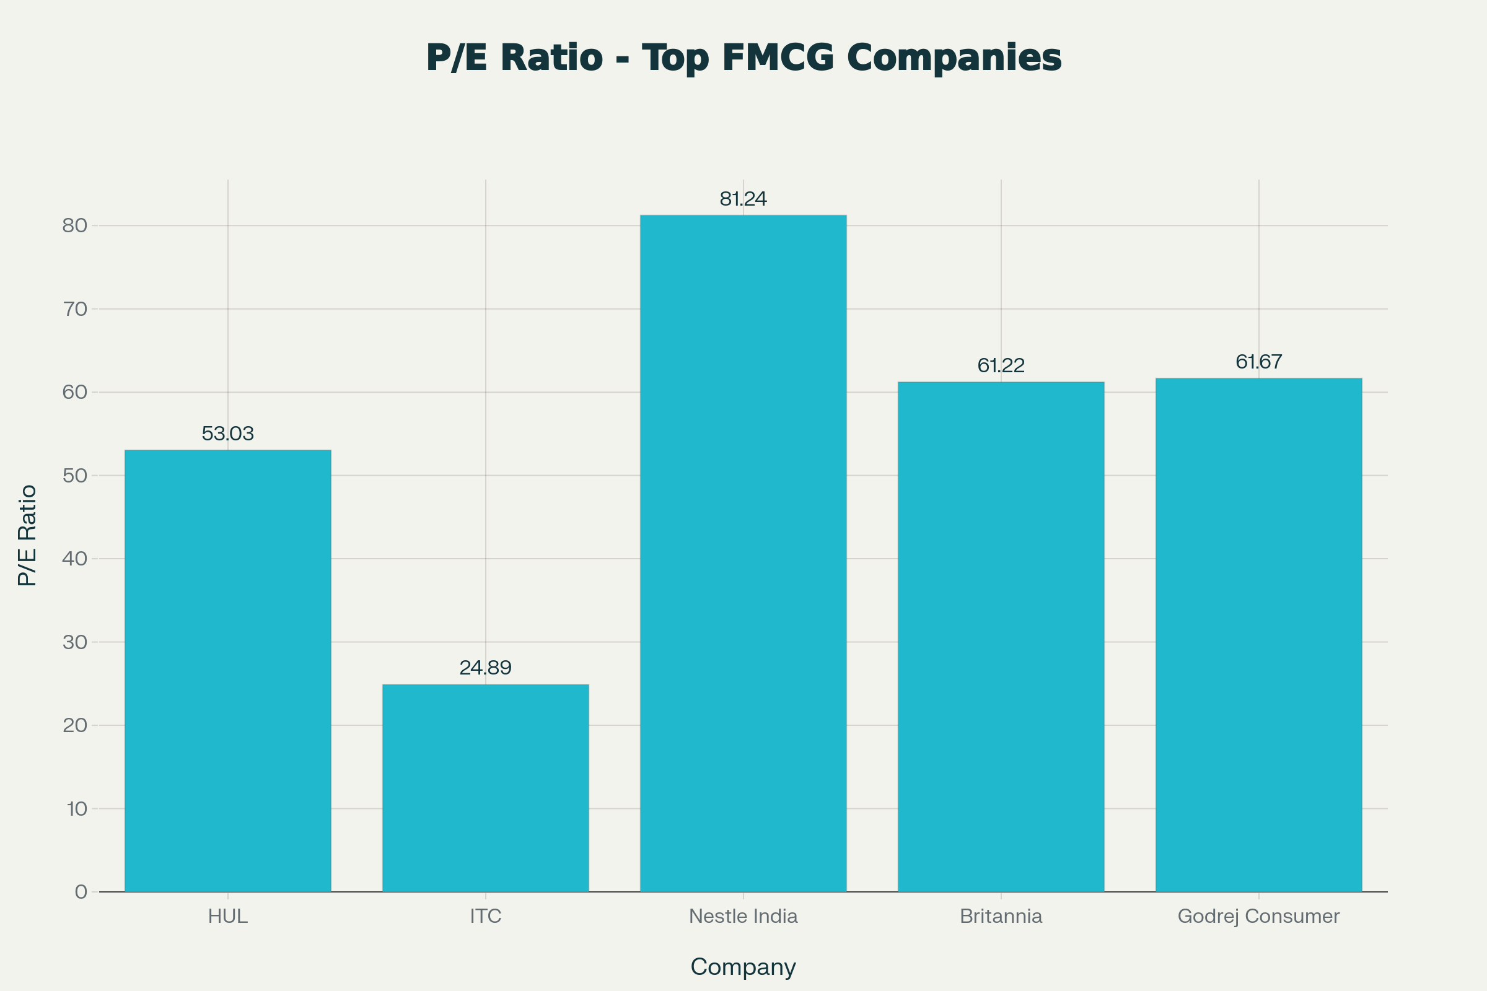
Valuation Analysis: Price-to-Earnings Ratio
Peer Average P/E: 56.41x | Sector Benchmark for quality FMCG

Slide 6
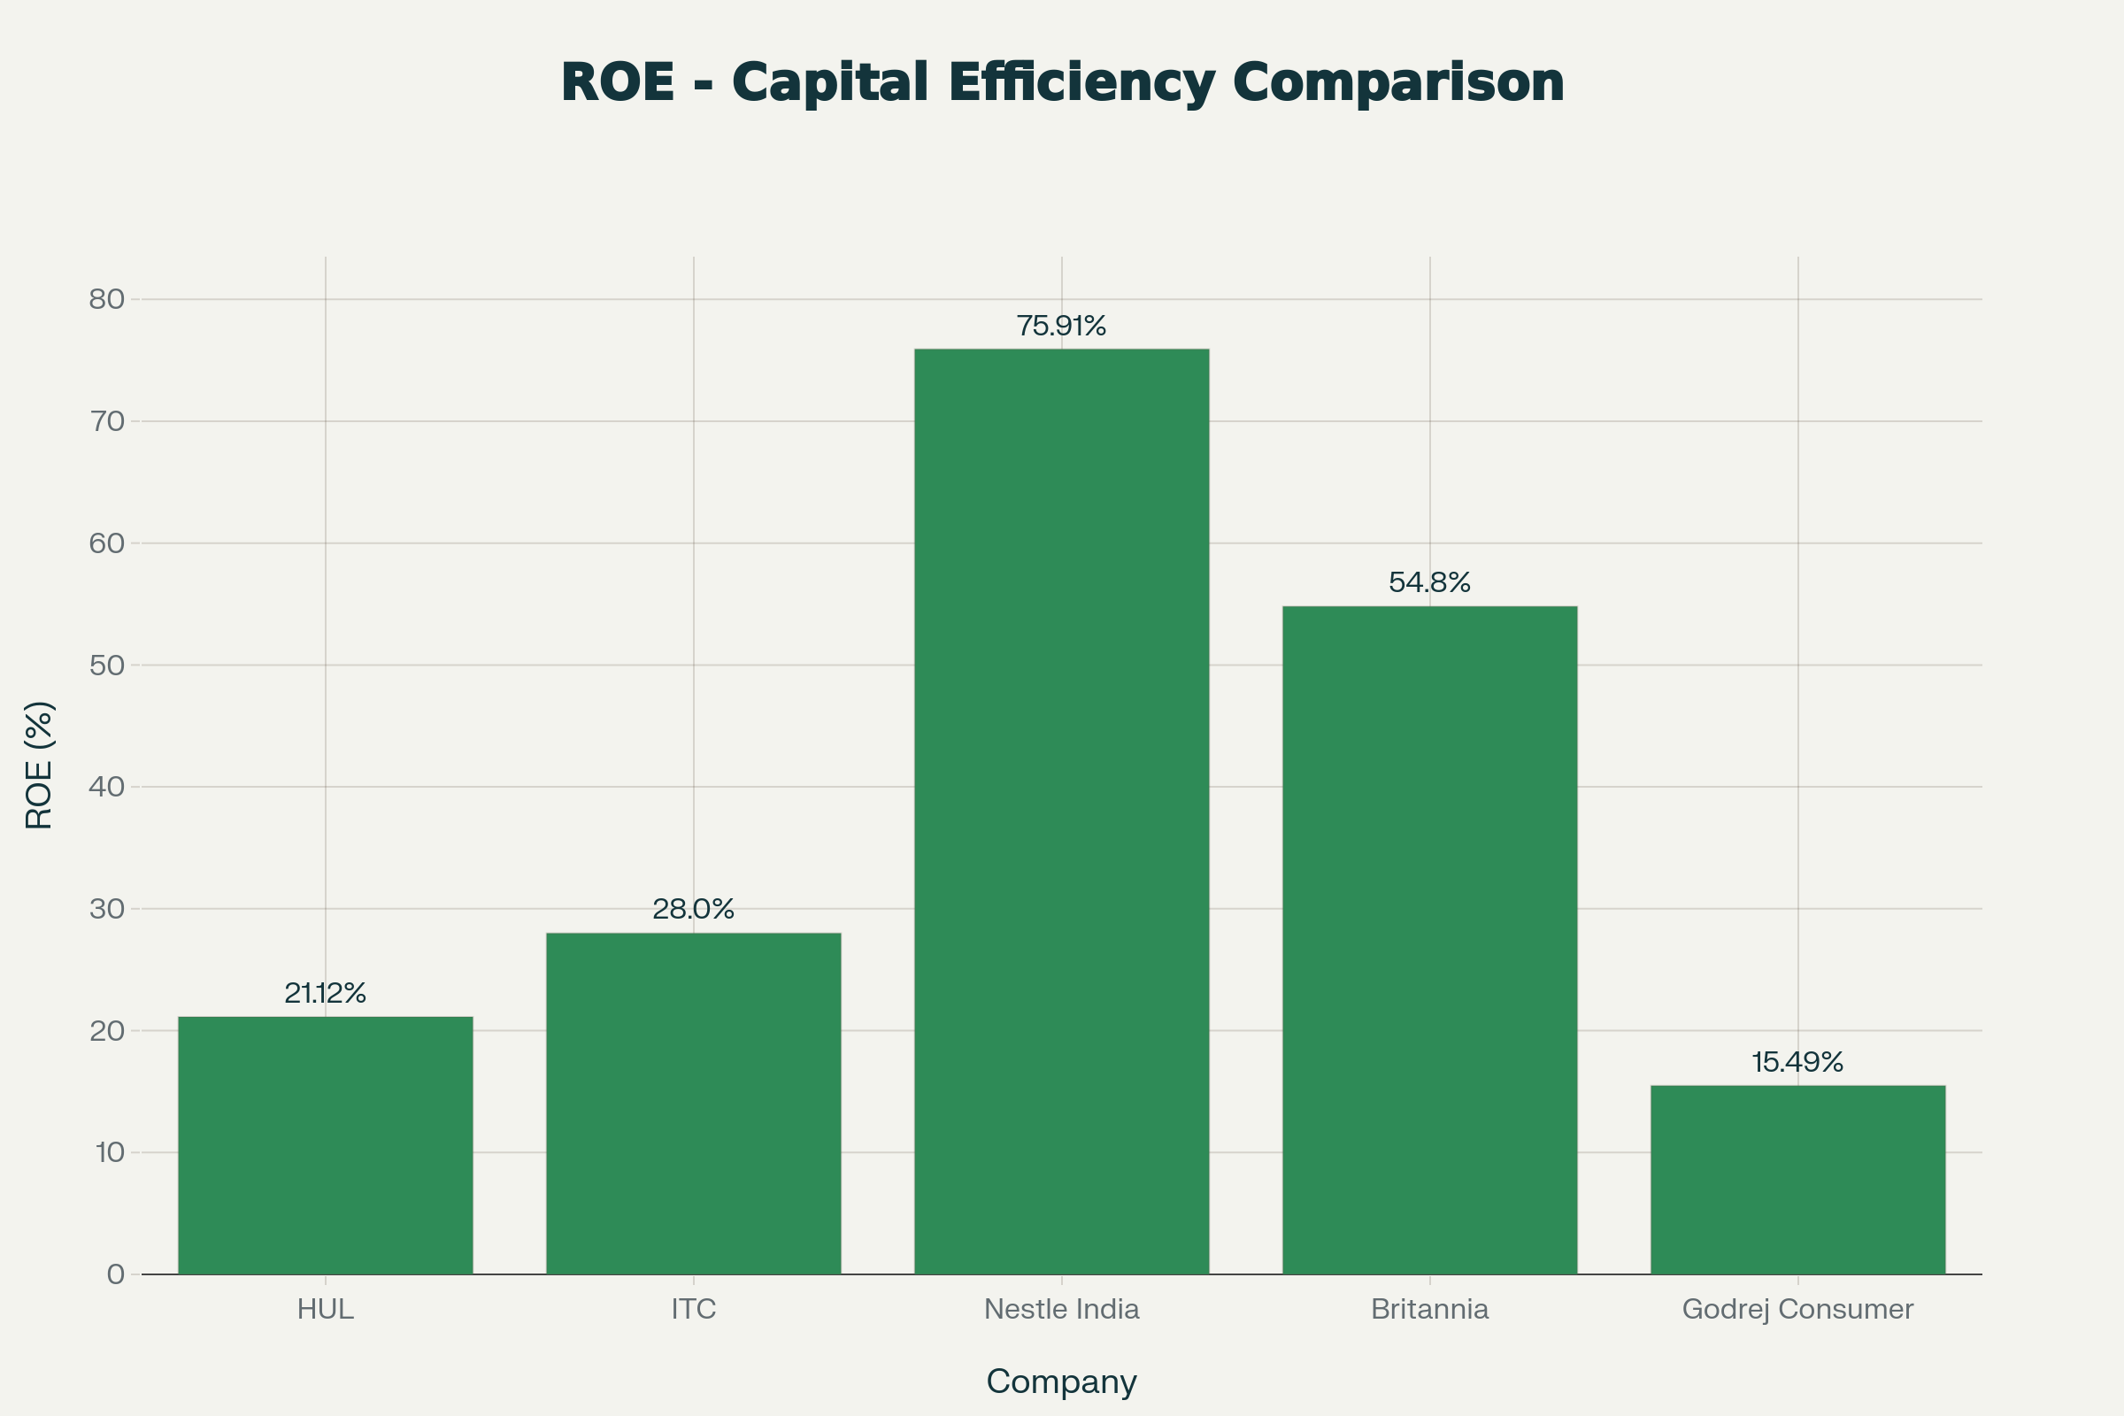
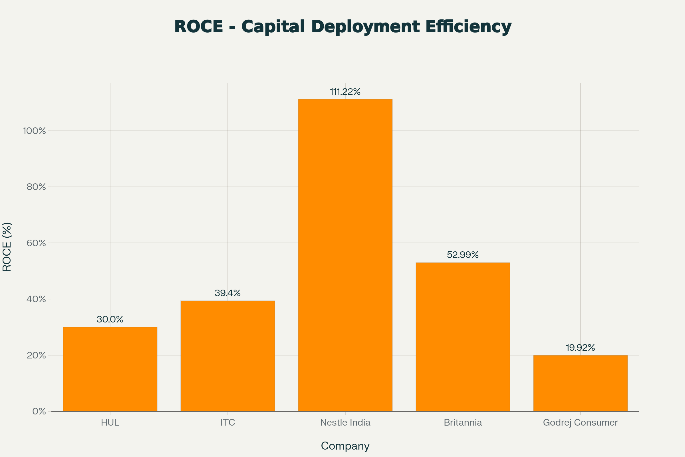
Capital Efficiency: ROE & ROCE Analysis
ROE % (Return on Equity)
🏆 Nestle India: 75.91%
Exceptional profit generation
⭐ Britannia: 54.80%
Superior management quality
✓ ITC: 28.0%
Solid diversified returns
HUL: 21.12% | Godrej: 15.49%
Below 25% quality threshold
ROCE % (Return on Capital Employed)
🏆 Nestle India: 111.22%
Best-in-class capital deployment
⭐ Britannia: 52.99%
Exceptional capital efficiency
✓ ITC: 39.4%
Strong operational returns
HUL: 30% | Godrej: 19.92%
Below 25% acceptable threshold

Slide 7
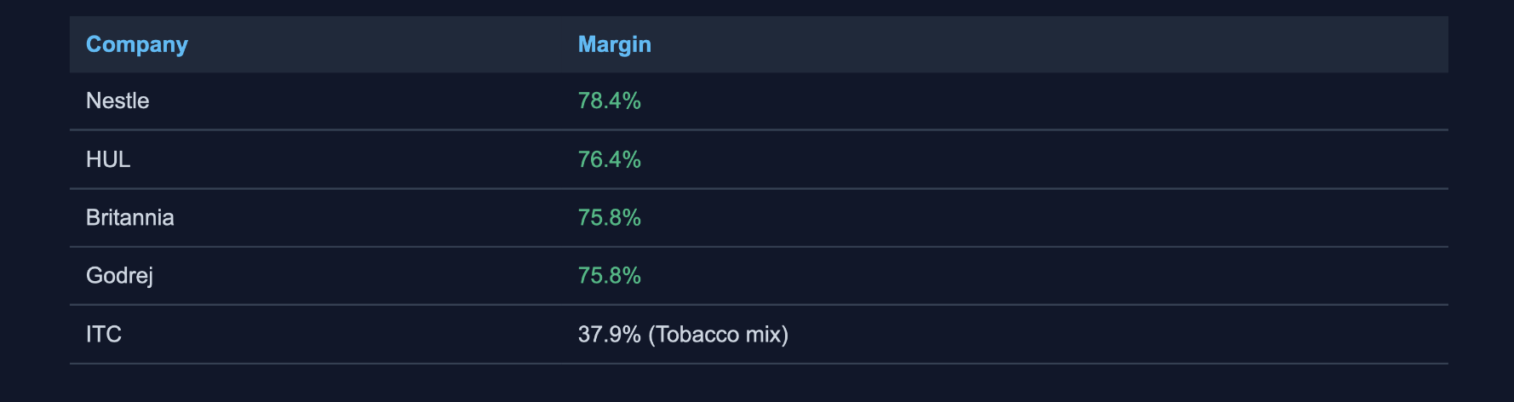
Profitability Margins Analysis
Gross Margin %
Net Profit Margin %

Slide 8
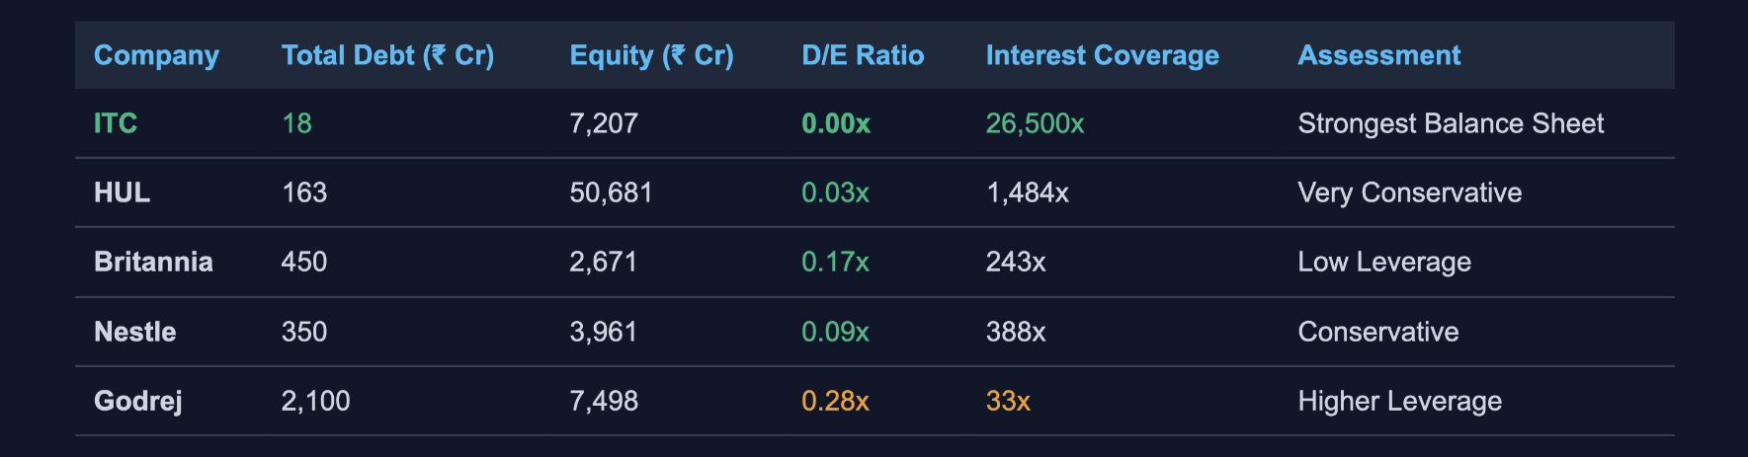
Financial Strength: Debt & Leverage Analysis
✓ FMCG Advantage: Asset-light business model allows minimal debt. All peers maintain investment-grade credit ratings.

Slide 9
🟢 STRONG BUY: ITC Limited
Valuation Attraction
P/E 24.89x (55.8% discount to peers)
Target Price: ₹520-550 (12 months)
Expected Return: 30-37%
Fundamental Strengths
✓ 14% market share (largest)
✓ 32% net margin (highest)
✓ Zero debt | ROCE: 39.4%
✓ ₹677Cr revenue (diversified)
Growth Catalysts
• Aashirvaad expansion in rural (8%+ growth)
• Premiumization trend (1.8x growth)
• D2C channels (45% YoY growth)
• E-Choupal platform advantages
Portfolio Allocation
Value Investors: ITC 60%
Growth Investors: ITC 50%
Dividend Seekers: ITC 40%
Dividend Yield: 2.15%

Slide 10
🟢 BUY: Britannia Industries
Quality Premium Play
P/E 61.22x (justified by quality)
Target Price: ₹6,500-7,000 (12 months)
Expected Return: 10-19%
Capital Efficiency
✓ ROE: 54.80% (top-tier)
✓ ROCE: 52.99% (exceptional)
✓ Gross Margin: 75.8%
✓ Net Margin: 13.0%
Business Quality
• #1 in biscuits category (strong moat)
• Consistent dividend payer
• Efficient operations (proven management)
• Pricing power in premium segment
Portfolio Allocation
Value Investors: Britannia 40%
Conservative: Britannia 40%
Growth Investors: Britannia 30%
Dividend Yield: 1.56%

Slide 11
🟡 HOLD: HUL & Nestle India
Nestle Exceptional Quality
HUL - Market Leader
Why HOLD (Not BUY):
✓ ROCE: 111.22% (best-in-class)
• P/E 53x reflects quality premium
✓ ROE: 75.91% (exceptional)
• Volume growth only 2% (below sector)
✓ Cerelac 96% market dominance
• Margin pressure: 16.9% net
✓ Premium brand positioning
• Mature valuations, limited upside
Target: ₹2,600-2,700 (5-9% return)
HUL Positives
✓ 12% market share (leader)
✓ Unmatched distribution (500K+ retailers)
✓ Global brands: Lux, Vaseline, Lipton
✓ Dividend: 1.74% yield
Nestle - Wait for Entry
Why HOLD (Don't Buy Now):
• P/E 81.24x (highest premium)
• 15-20% overvalued at current levels
• Single category risk (Cerelac 96%)
• Wait for 8-10% correction
Current: ₹1,260 | Target: ₹1,350-1,450

Slide 12
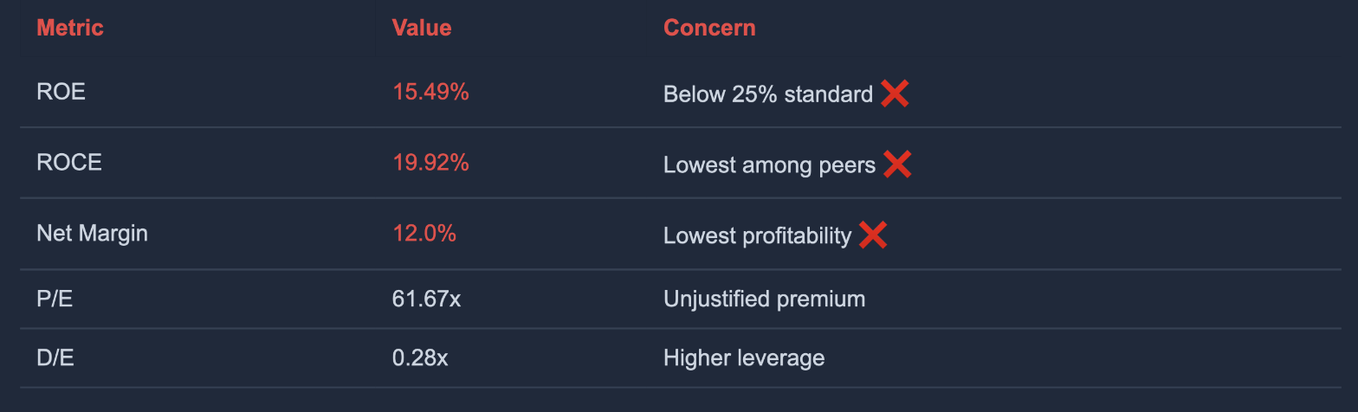
🔴 REDUCE: Godrej Consumer Products
Operational Concerns ⚠️
Competitive Position
❌ Market Share: 2% (Niche player)
❌ Scale: Unable to compete with HUL/ITC
❌ Efficiency: Structural profitability issues
❌ Alternatives: ITC & Britannia offer better risk-reward
Action: Avoid or exit positions
Expected return: -3 to -7%

Slide 13
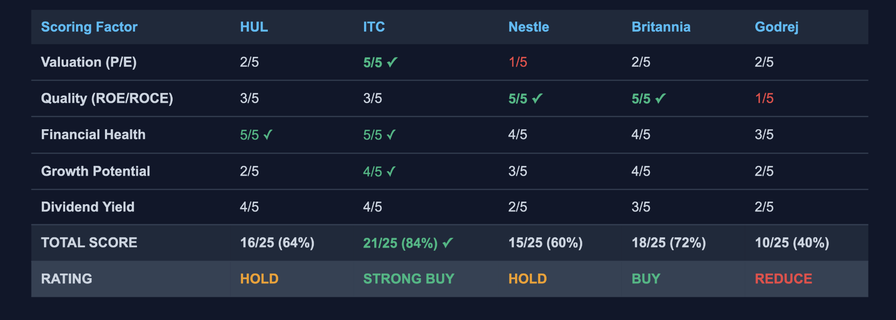
Composite Valuation Scoring (Detailed)

Slide 14
Portfolio Construction: Investor-Type Recommendations
💳 Dividend Seekers
💰 Value Investors
Allocation:
Allocation:
ITC 40% + HUL 35% + Britannia 25%
ITC 60% + Britannia 40%
12-Month Return:
12-Month Return:
18-25%
30-40%
Income + appreciation
Best value-quality blend
🛡️ Conservative Investors
Allocation:
HUL 40% + Britannia 40% + Nestle 20%
12-Month Return:
15-20%
Dividend + growth balance
📈 Growth Investors
Allocation:
ITC 50% + Britannia 30% + Nestle 20%
12-Month Return:
25-35%
Growth with quality

Slide 15
Risk Analysis & Mitigation Strategies
Macro Risks
🔴 Economic Recession
FMCG defensive, Nestle most resilient
🟠 Input Cost Inflation
Pricing power in premium, hedging programs
🟡 Currency Volatility
Minimal exposure (local costs)
Company-Specific Risks
ITC: Tobacco Regulation
Priced in; FMCG diversification offsets
HUL: Margin Compression
Efficiency programs + price hikes
Nestle: Single Category Risk
Cerelac growth ceiling, new categories expanding
Mitigation Strategies
✓ Portfolio diversification (multiple companies)
✓ Phase-wise investment (cost averaging)
✓ Regular monitoring (quarterly results)
✓ Exit triggers (fundamentals deteriorate)
✓ Rebalancing (lock gains, reduce risk)

Slide 16
Implementation Roadmap & Key Metrics
Phase 1: Immediate
Next 1-2 Months
• Buy ITC on dips <₹390
• Build Britannia position
• Monitor quarterly results
Phase 2: Medium-term
2-6 Months
• Track earnings growth
• Add on 10%+ dips
• Review market share trends
Phase 3: Long-term
6-12 Months
• Take 30-40% profits from ITC
• Rebalance portfolio
• Lock gains & manage risk
Key Metrics to Monitor
✓ ITC FMCG Growth: Confirm >10%
✓ Britannia ROE: Maintain >50%
✓ HUL Volume: Accelerate >3%
✓ Sector CAGR: Track 17%+ growth

Slide 17
Investment Decision Framework
Market Opportunity: Indian FMCG projected to reach USD 1.1T by 2033
Growth Thesis: 17.33% CAGR driven by urbanization, premiumization, e-commerce
Best Value Play: ITC at 24.89x P/E with 30-37% upside
Quality Alternative: Britannia with 54.80% ROE at reasonable valuation
Recommended Portfolio: 60% ITC + 40% Britannia
Expected 12-Month Return: 30-40%

Slide 18
Key Takeaways & Next Steps
✓ Sector Strength
✓ Action Items
Defensive & growing (17.33% CAGR)
All peers: strong balance sheets
Low leverage (D/E <0.3x)
High dividend capacity
Build ITC on dips <₹390
Accumulate Britannia on weakness
Monitor Q3 FY26 earnings
Review quarterly progress
✓ Investment Opportunity
ITC undervalued vs peers (55% discount)
Britannia quality at fair premium
Multiple growth drivers active
Risk-reward favorable

